Slide 1

CSC3007 information visualization Milestone one
Group P1 - 2:
Lim Chye Ya
Benedict Lee
Areeve Gam

Slide 2
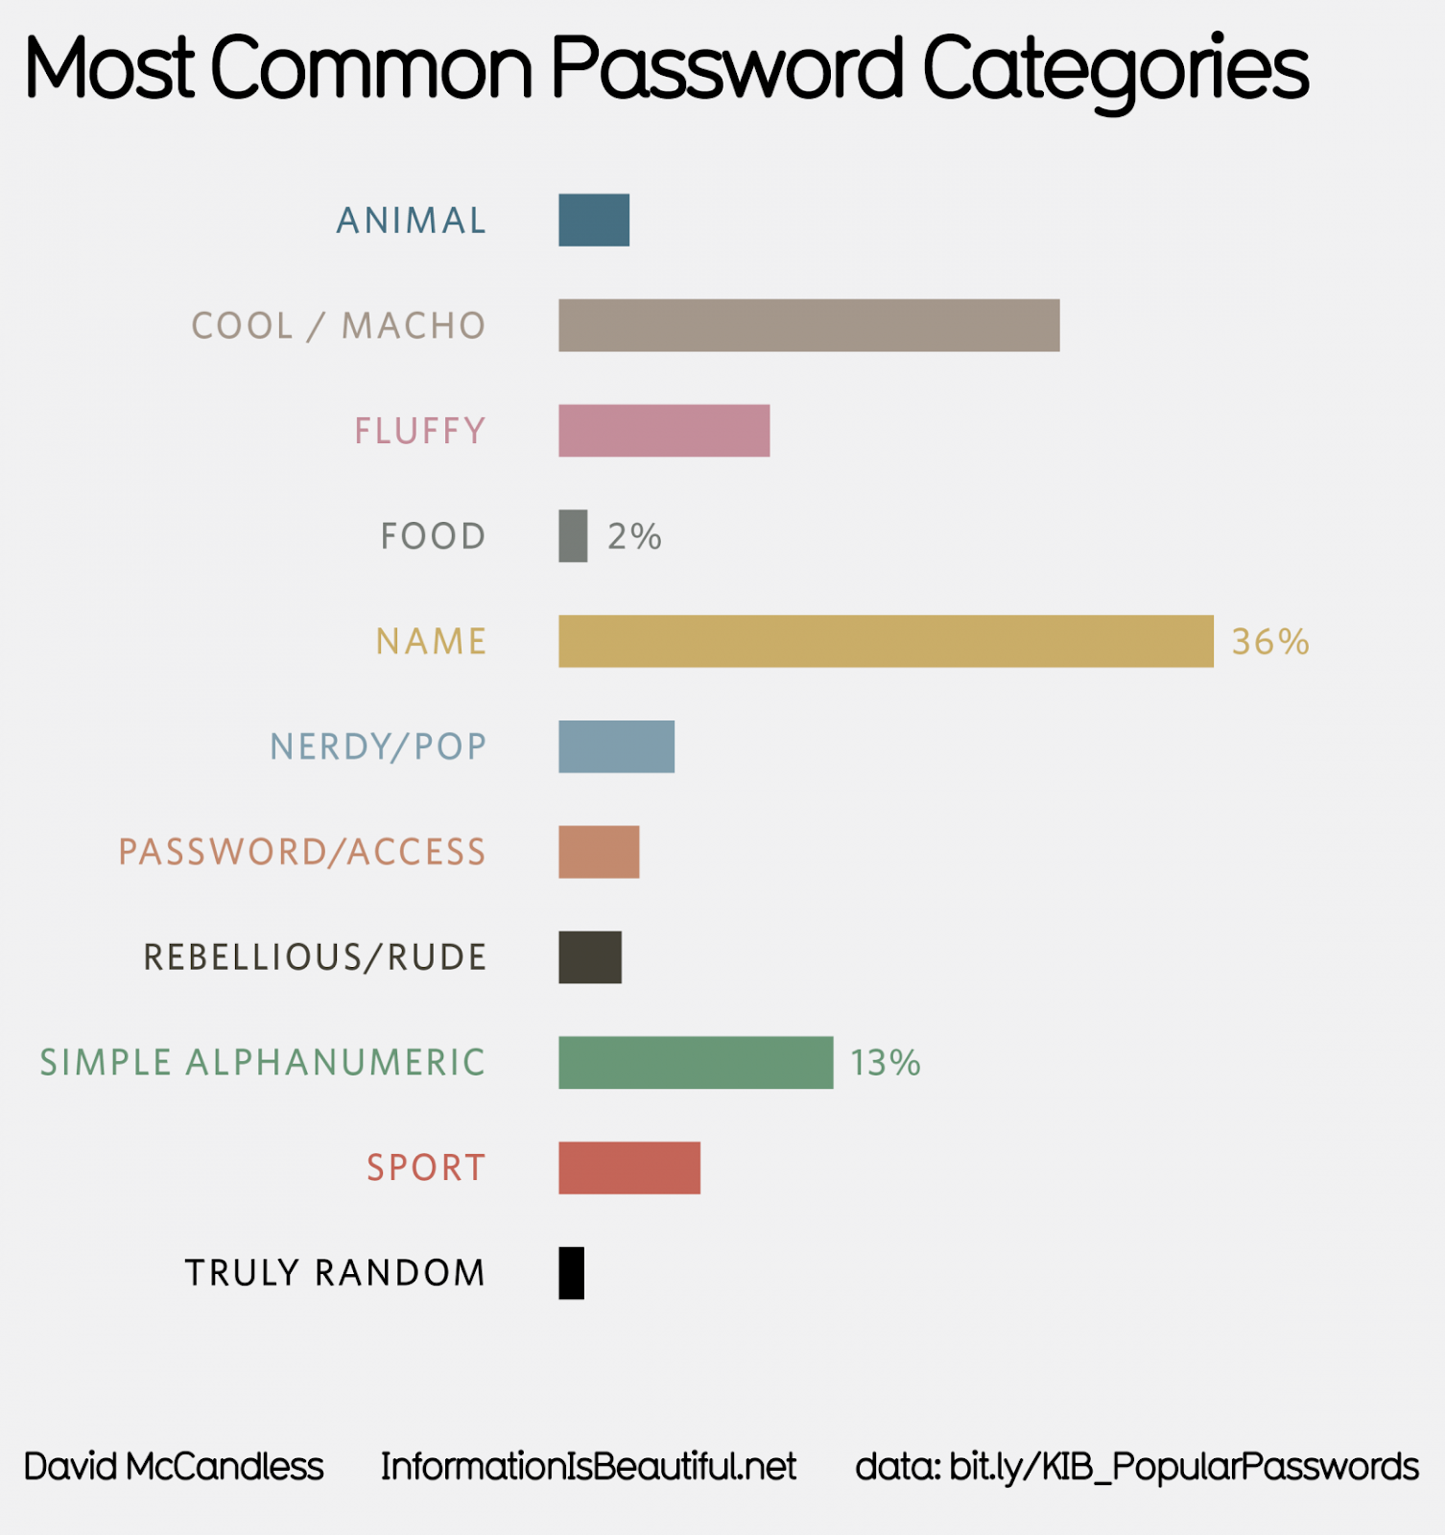
Visualization one
Notes:
https://informationisbeautiful.net/visualizations/top-500-passwords-visualized/
1. Evaluate the most common password
2. Educate user on security aspect when choosing an unique password

Slide 3
task
Evaluate the most common password
Educate user on security aspect when choosing an unique password

Slide 4
Idiom
Color is used to identify different category of the common password
Bar include quantitative results to indicate the number of frequently used password

Slide 5
Critique
Unable to identify the weightage between category without the frequencies (Truly Random & Food)
Colour Scheme used is similar leading to confusion (Truly Random & Rebellious)

Slide 6
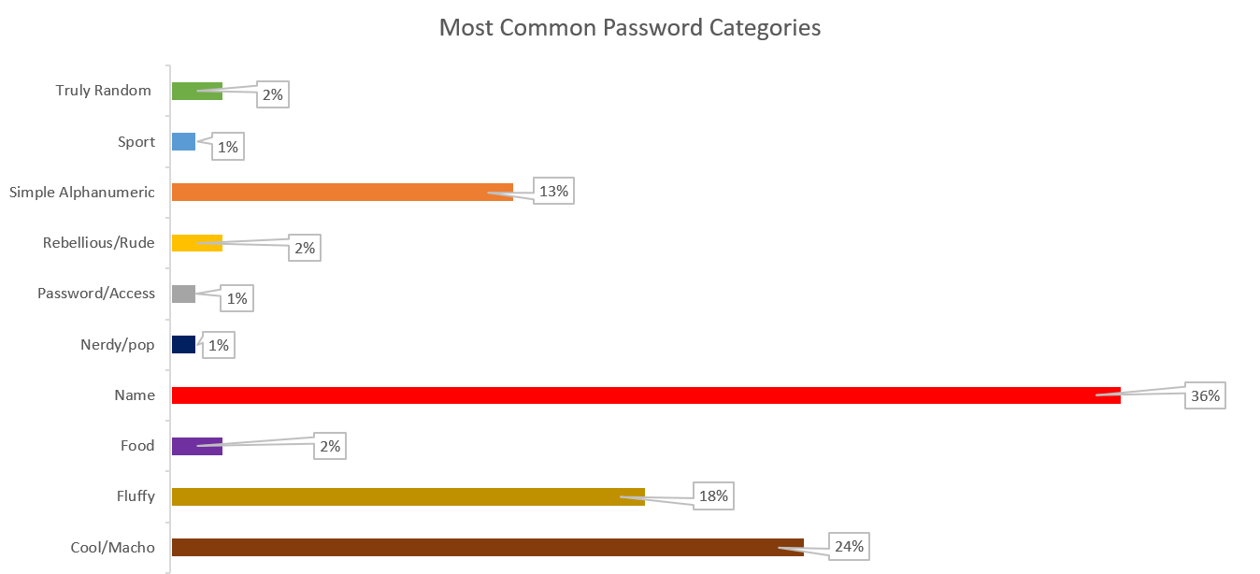
Visualization one: suggestion

Slide 7
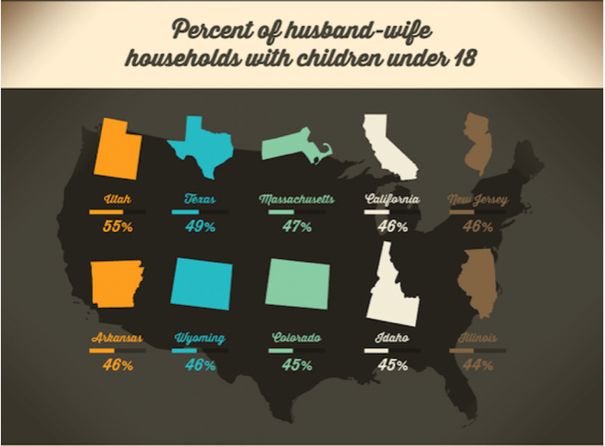
Visualization two
Notes:
https://visual.ly/community/Infographics/home/whos-living-together

Slide 8
Critique
Not all 50 states are represented
One colour represents two states, violate the colour channel principle
Wyoming & Colorado have the same outline
All the bar graphs look similar

Slide 9
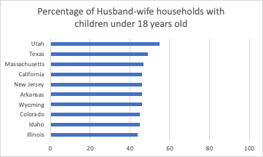
Visualization two: suggestion

